Slide 1
Digital Image Processing
Associate Prof. Zhang Qingfeng(张庆丰) Department of Computer Science, Jinan University
Office Room: 415, Nanhailou Building
Email: zqf135@qq.com
1

Slide 2
Chapter 4
Filtering in the frequency Domain (I)
2

Slide 3
Contents
1. Background
2. Preliminary Concepts
3. The Discrete Fourier Transform
4. Some properties of the 2-D DFT
5. Convolution theory
3

Slide 4
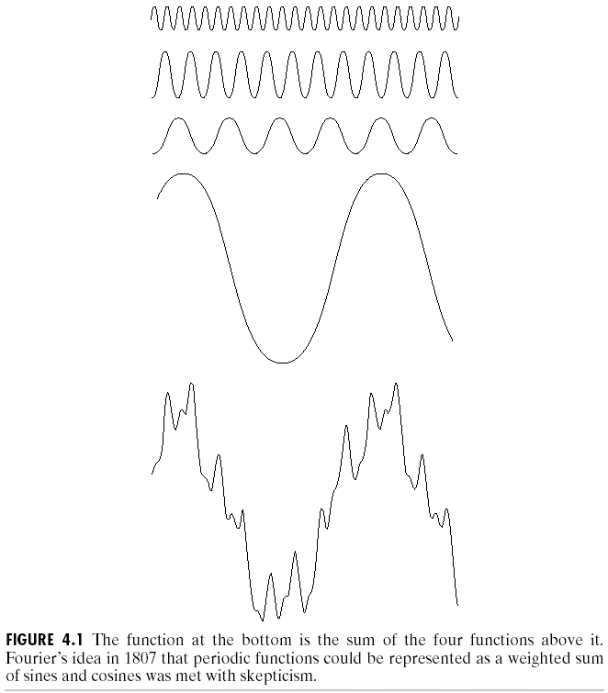
1. Background
Fourier Series and Transform
Jean Baptiste Joseph['dʒəʊzɪf]
Fourier [ˈfuriei] ( born in 1768)
Any periodic function can be expressed as a weighted sum of sines and/or cosines (Fourier series)

Slide 5
Background
Other functions that are not periodic can be expressed as an integral of sines and/or cosines multiplied by a weighing function (the formulation in this case is Fourier Transform)
Functions can be recovered by the inverse operation with no loss of information
Applications to Image Enhancement

Slide 6
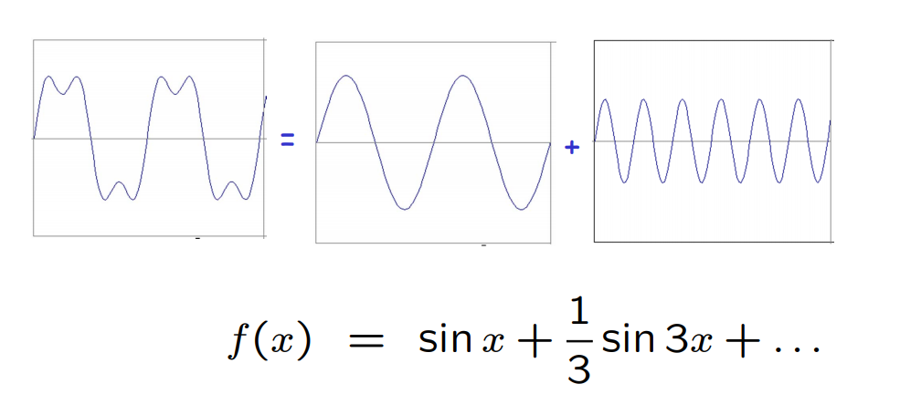
Exmaple
6

Slide 7
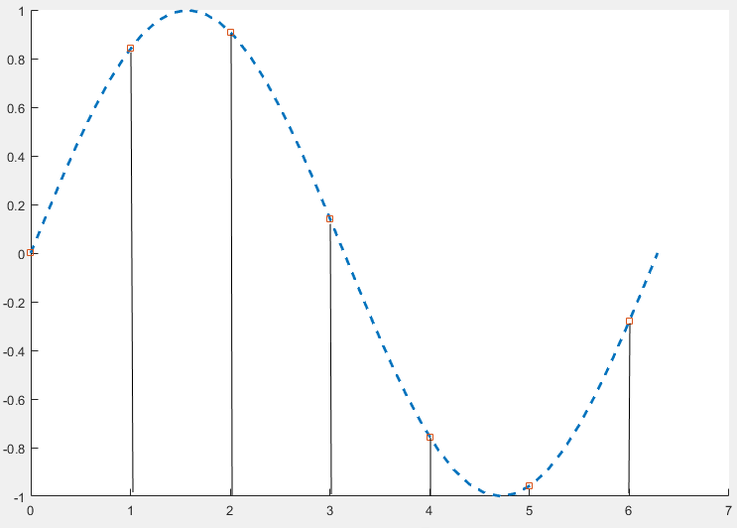
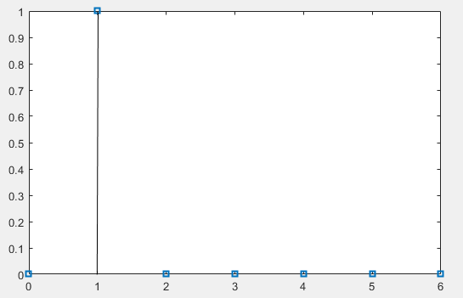
Example
f(x)
Sin(0x) Sin(1x) Sin(2x) Sin(3x) Sin(4x) Sin(5x) Sin(6x)
x
1D image，7 samples（0-6），f(x)=sin(x)

Slide 8
2. Preliminary Concepts
Complex Numbers
Complex number is defined as
C=R + jI ; where
R denotes the real part of the complex number and I its imaginary part ;
Conjugate ( 共轭 ) of a complex number C, denoted C* : C * =R – jI
Complex number R+jI is a point in the rectangular coordinate system of the complex plane

Slide 9
Complex Numbers
can be represented in polar coordinates by
Where is the length of the vector from the origin of the complex plane to point (R,I).
is the angle between the vector and the real axis.
Euler’s formula

Slide 10
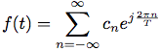
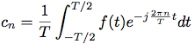
3、The Discrete Fourier Transform
Fourier Series （傅里叶级数）
If f(t) is a periodic function of a continuous variable t, with period T
where
Notes:
It is called Fourier series

Slide 11
1D Discrete Fourier Transform
The one-dimensional Fourier transform (discrete case) DFT
Frequency (time) domain: the domain (values of u) over which the values of F(u) range; because u determines the frequency of the components of the transform.
Frequency (time) component: each of the M terms of F(u).
11

Slide 12
F(u) can be expressed in polar coordinates:
R(u): the real part of F(u)
I(u): the imaginary part of F(u)
Power spectrum (spectral density)功率谱:
12

Slide 13
1D Discrete Inverse Fourier Transform
Given F(u), we can get the original function using the one-dimensional Inverse Fourier transform
13

Slide 14
1D Forward（inverse）DFT
Forward Discrete Fourier transform
Inverse Discrete Fourier transform
14

Slide 15
2D DFT
The 2D Fourier transform and its inverse
Fourier transform (discrete case)
Let f(x,y) for x=0,1,2, ..., M-1 and y=1,2, ..., N-1 denote an M×N image. The 2D DFT of f is given by
The frequency domain is simply the coordinate system spanned by F(u,v) with u and v as frequency variables.

Slide 16
2D inverse DFT
Inverse Fourier transform (discrete case)
u, v : the transform or frequency variables
x, y : the spatial or image variables
Thus, given F(u,v), we can obtain f(x,y) back by means of the inverse DFT.

Slide 17
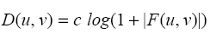
Visualizing DFT
Typically, we visualize |F(u,v)|
The dynamic range of |F(u,v)| is typically very large
Apply streching:
(c is a const)
|F(u,v)|
|D(u,v)|
original image
before stretching
after stretching

Slide 18
4、DFT Properties
(1) dc component(直流分量)
The value of the transform at the origin of the frequency domain that is F(0,0) is called the dc component(直流分量) of the Fourier transform.
(2) FT is complex
Even if f(x,y) is real, its transform is complex.

Slide 19
DFT Properties
(3) Separability
The 2D DFT can be computed using 1D transforms only:
Forward DFT:
kernel is
separable:
19

Slide 20
DFT Properties
Rewrite F(u,v) as follows:
Let’s set:
Then:
20

Slide 21
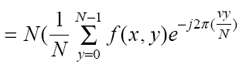
DFT Properties
How can we compute F(x,v)?
How can we compute F(u,v)?
)
N x DFT of rows of f(x,y)
DFT of cols of F(x,v)
21

Slide 22
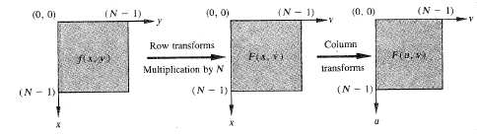
DFT Properties
22

Slide 23
DFT Properties
(4) Periodicity
The DFT and its inverse are periodic with period N
23

Slide 24
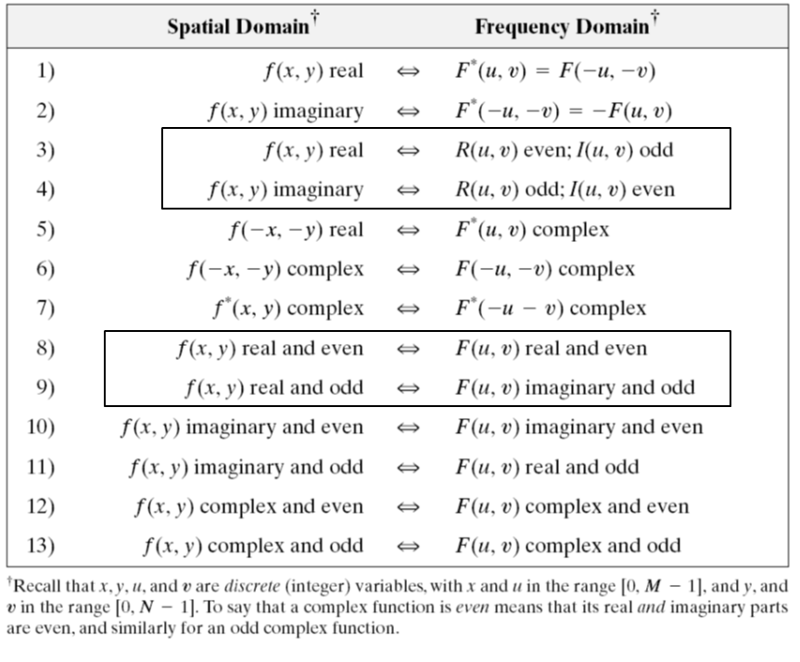
DFT Properties
(5) Symmetry
24

Slide 25
DFT Properties
(6) translation
f(x,y) F(u,v)
Translation in spatial domain:
Translation in frequency domain:
25

Slide 26
DFT Properties
To “see” a full period, we need to translate the origin of the transform at u=N/2 (or (N/2,N/2) in 2D)
|F(u)|
|F(u-N/2)|
26

Slide 27
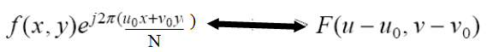
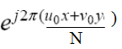
DFT Properties
To move F(u,v) at (N/2, N/2), take
27

Slide 28

DFT Properties
sinc
sinc
no translation
after translation
28

Slide 29
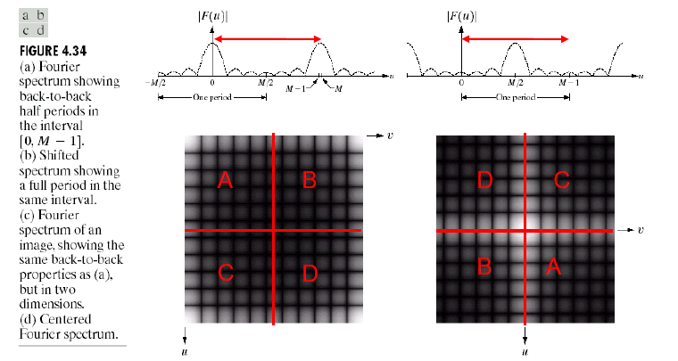
29

Slide 30
DFT Properties
(7) Scale
(8) Rotation
Rotating f(x,y) by θ rotates F(u,v) by θ
30

Slide 31
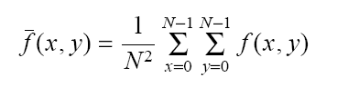
DFT Properties
(9) Average
Average:
F(u,v) at u=0, v=0:
So:
31

Slide 32
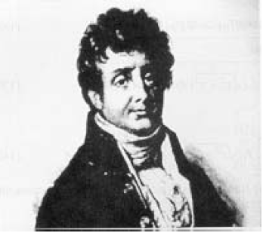
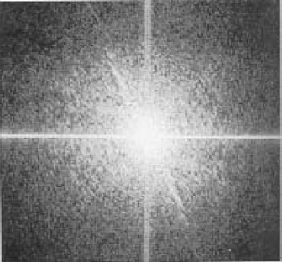
Magnitude and Phase of DFT
What is more important?
Hint: use the inverse DFT to reconstruct the input image using only magnitude or phase information
magnitude
phase
32

Slide 33
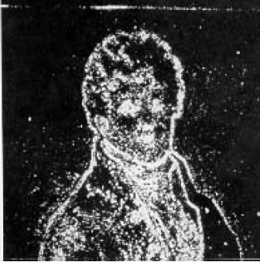
Reconstructed image using
magnitude only
(i.e., magnitude determines the
strength of each component)
Reconstructed image using
phase only
(i.e., phase determines
the phase of each component)
33

Slide 34
34

Slide 35
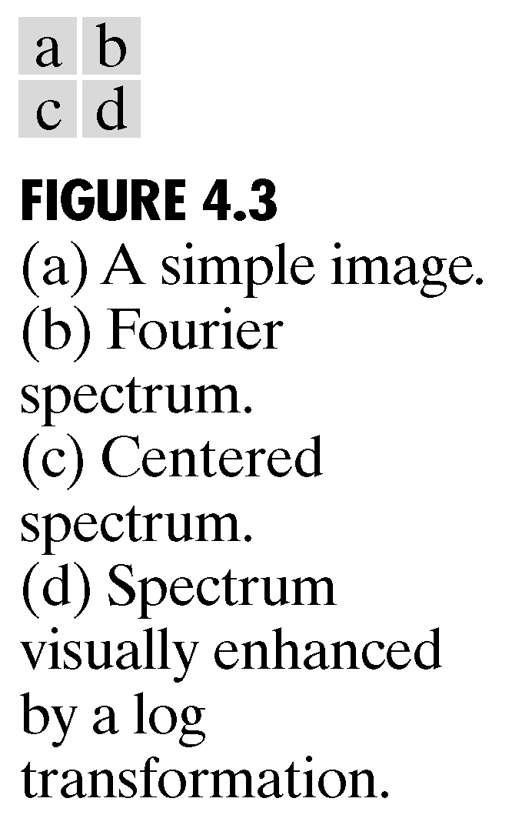
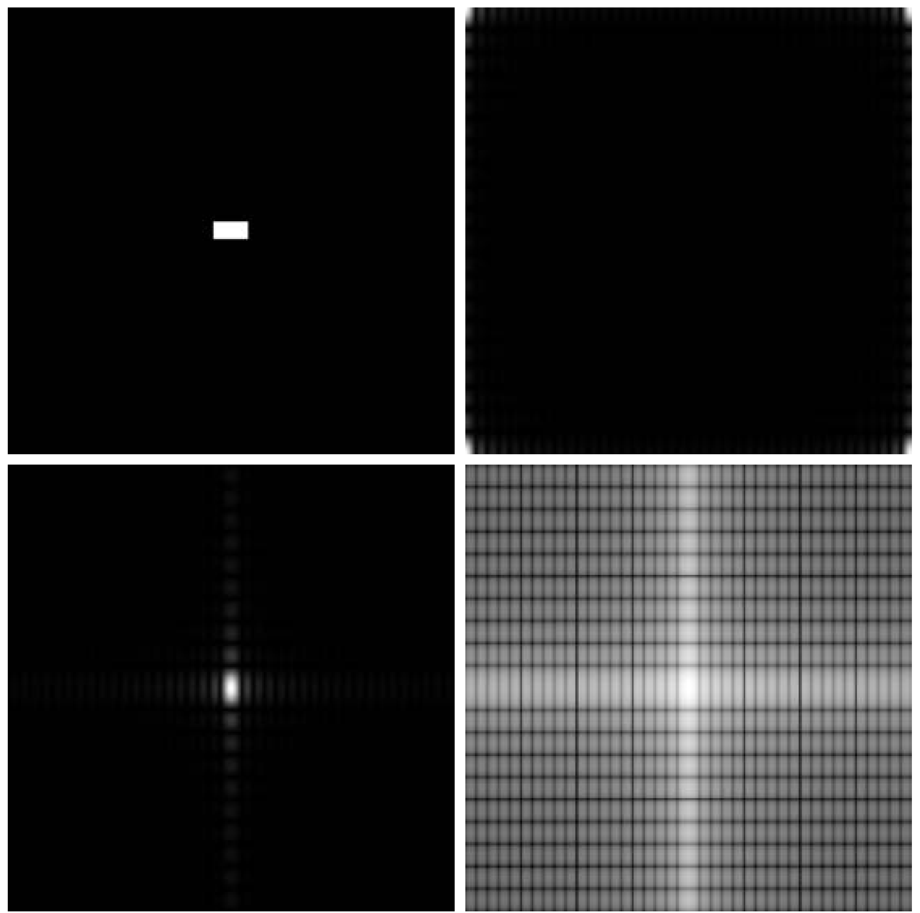
DFT Example
35

Slide 36

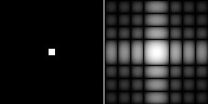
Example: Two-Dimensional DFT with Different Functions
Sine wave
Its DFT
Rectangle
Its DFT

Slide 37
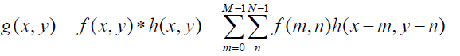
5、Convolution Theory
Convolution theory is the bridge connecting spatial domain and frequency (Fourier) domain
Convolution of two functions f(x,y) and h(x,y) of size M×N is defined by
If the size of h(x,y) is smaller than M×N, it is first padded by zero to make the size M×N􀂄
f(x,y) and h(x,y) are inherently(固有的) periodic (周期性)􀂄
37

Slide 38
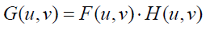
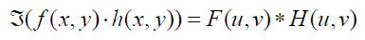
Convolution theory says that the Fourier transform of g(x,y) is equal to the product of the Fourier transform f(x,y) and that of h(x,y)􀂄
Similarly the Fourier transform of the product of f(x,y) and h(x,y) is equal to the convolution of the Fourier transform of f(x,y) and that of h(x,y)
38

Slide 39
Summary
In this lecture, we have learned
Preliminary Concepts
The Discrete Fourier Transform of 1D and 2D
Some Properties of the 2-D Discrete Fourier Transform
39

Slide 40
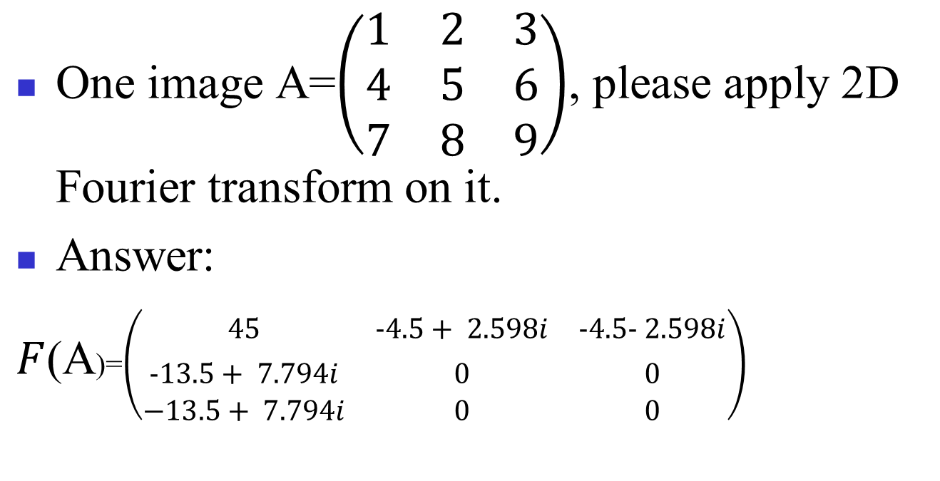
problem
One image A=$\left(\begin{matrix}1 & 2 & 3 \\ 4 & 5 & 6 \\ 7 & 8 & 9\end{matrix}\right)$, please apply 2D Fourier transform on it.
Answer:
$F$(A)=$\left(\begin{matrix}45 & −4.5+ 2.598i & −4.5− 2.598i \\ −13.5+ 7.794i & 0 & 0 \\ −13.5+ 7.794i & 0 & 0\end{matrix}\right)$

